Slide 1
Weekly Report
Dian Hanifudin Subhi

Slide 2
Outline
Weekly report
Summary of this week’s work
Your work
Conclusion
Your opinion/thought
Action item

Slide 3
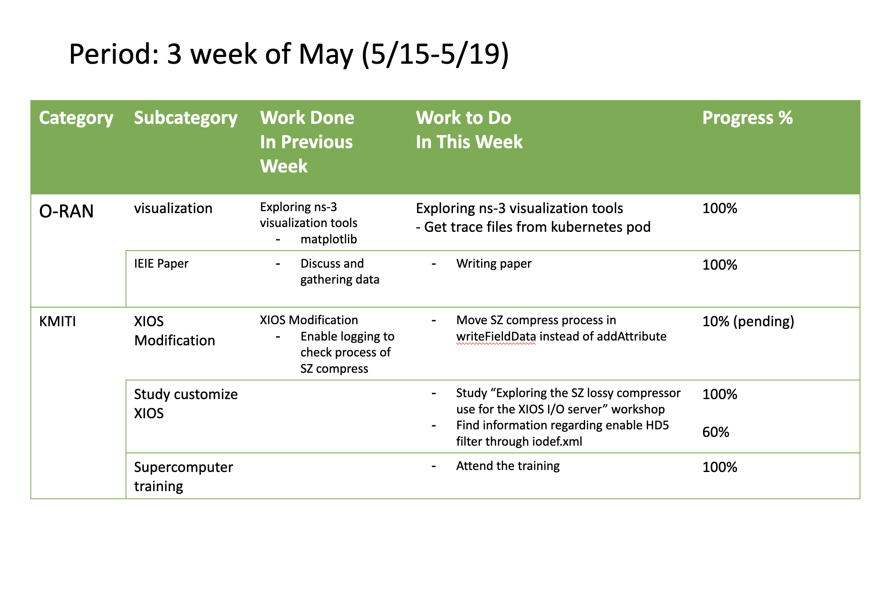
Weekly report

Slide 4
Summary of work this week
Exploring ns-3 visualization tools
Find information regarding HDF5 filter integration through XIOS
Supercomputer training

Slide 5
Question to be Answered
How is the progress of the ns-3 visualization?
What is required to enable HDF5-filter through XIOS?

Slide 6
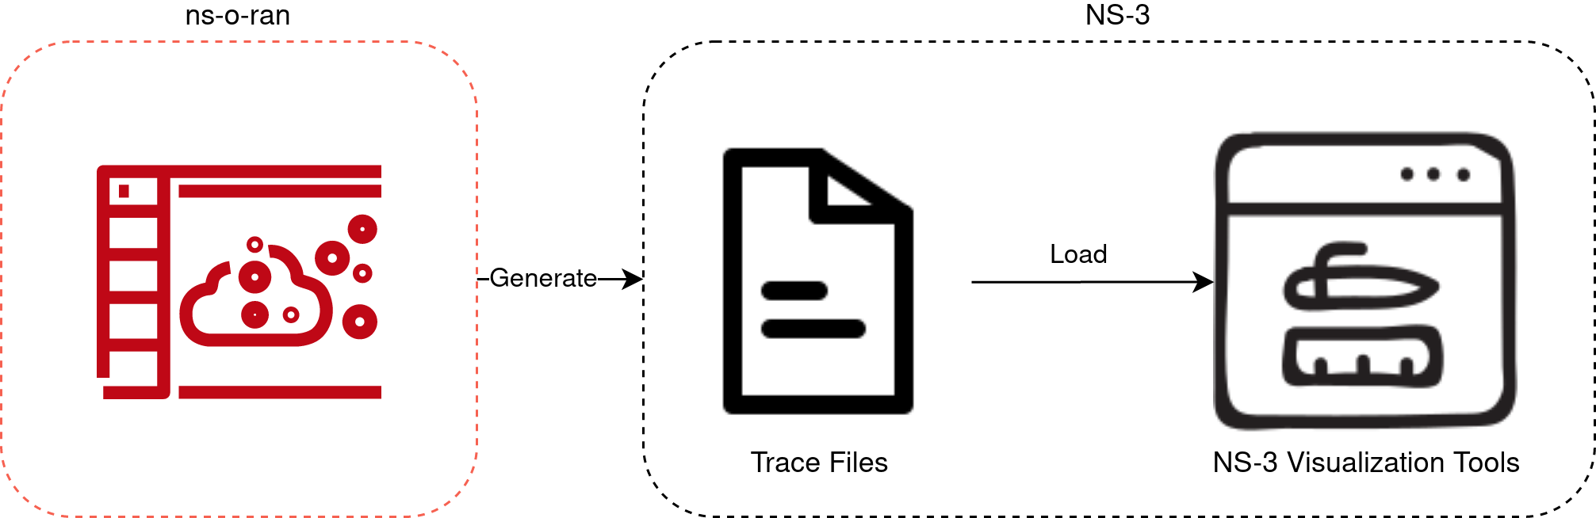
NS-3 visualization
block diagram

Slide 7
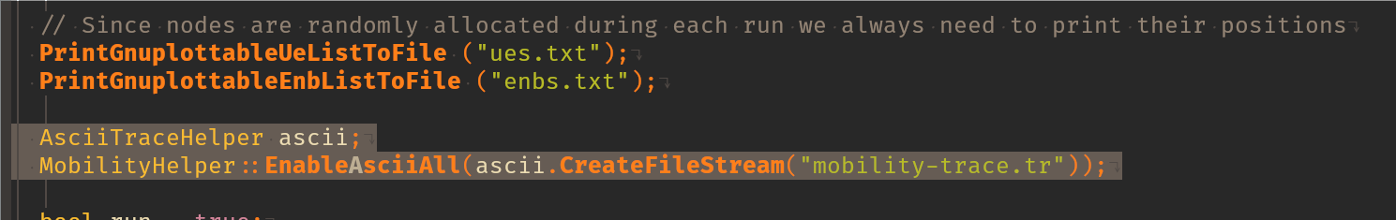
NS-3 visualization
Enable trace inside the ns-sd-ran pod
Add AsciiTraceHelper inside the scenario C++ file
Specify the output trace location
Recompile then run using ./waf script tools to get the trace files.

Slide 8
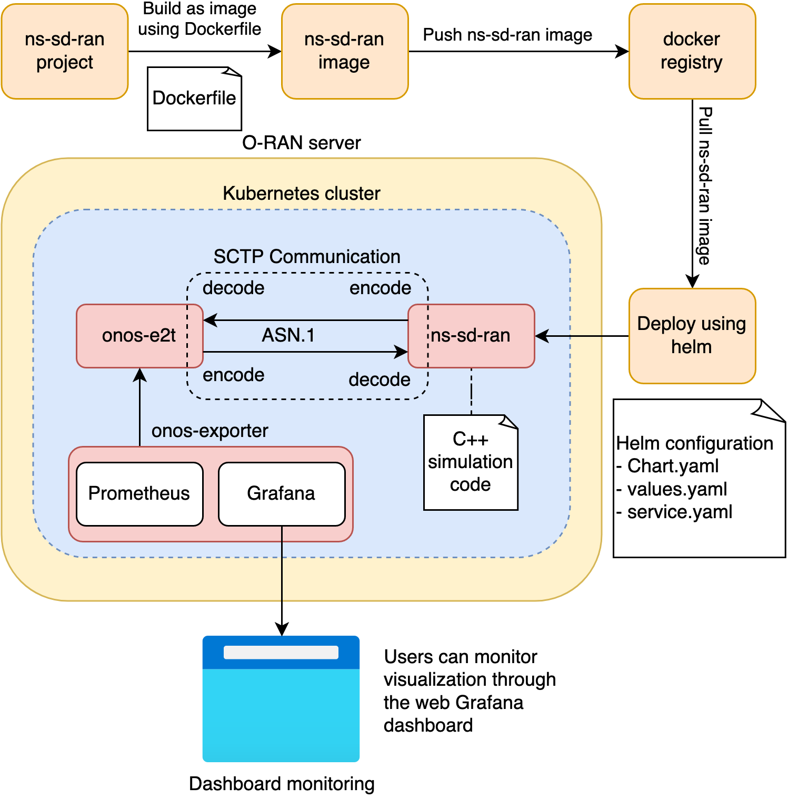
Writing IEIE paper
System model

Slide 9
Study customize XIOS
Exploring the SZ lossy compressor use for the XIOS I/O server
Xavier Yepes-Arbós publish a presentation regarding using SZ lossy compressor for the XIOS I/O server at 12th JLESC workshop
The default lossless compression filter of HDF5 does not suitable, because if compression ratio is high, it takes too much time.
No available journal, limited to abstract only. It can be accessed on https://meetingorganizer.copernicus.org/EGU22/EGU22-9153.html?pdf
The abstract mention using SZ lossy compression filters

Slide 10
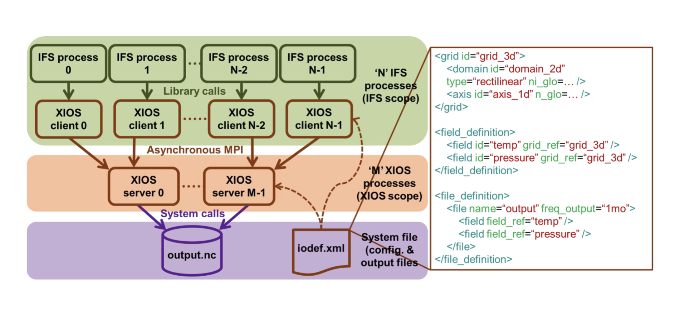
Study customize XIOS
Exploring the SZ lossy compressor use for the XIOS I/O server

Slide 11
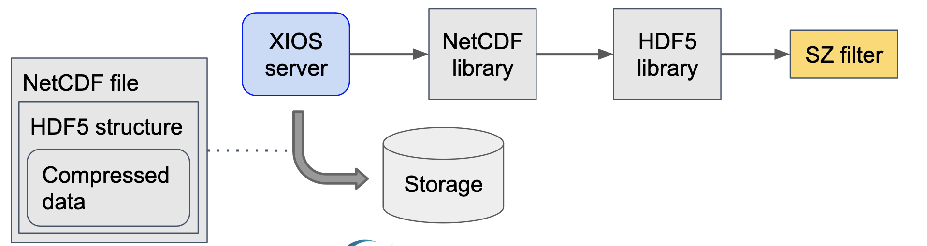
Study customize XIOS
Exploring the SZ lossy compressor use for the XIOS I/O server

Slide 12
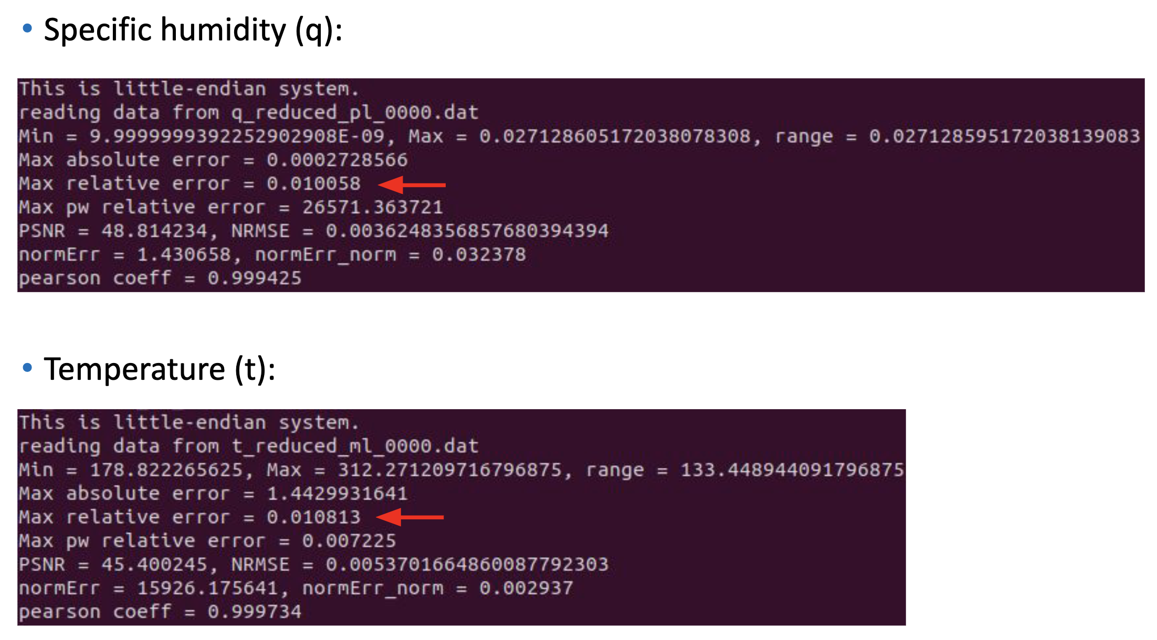
Study customize XIOS
Exploring the SZ lossy compressor use for the XIOS I/O server

Slide 13
Study customize XIOS
H5Z-SZ HDF5 filter based on SZ compressor
Dr. Sheng Di develop H5Z-SZ HDF5 filter based on SZ compressor
H5Z-SZ filter has been integrated in SZ package: see the hdf5_filter directory

Slide 14
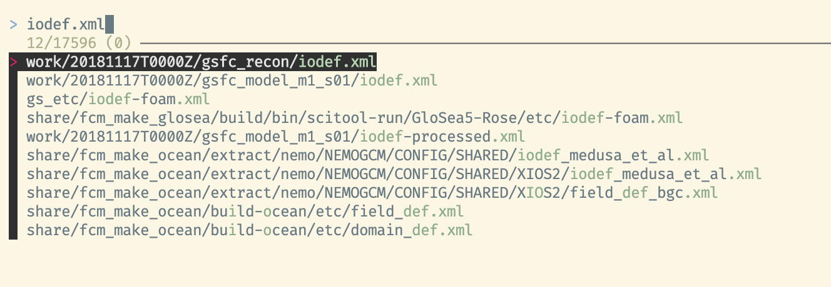
Study customize XIOS
Find iodef.xml regarding the Low GloSea6
Found the iodef.xml at gsfc_recon and gsfc_model_m1_s01 CYLC task.

Slide 15
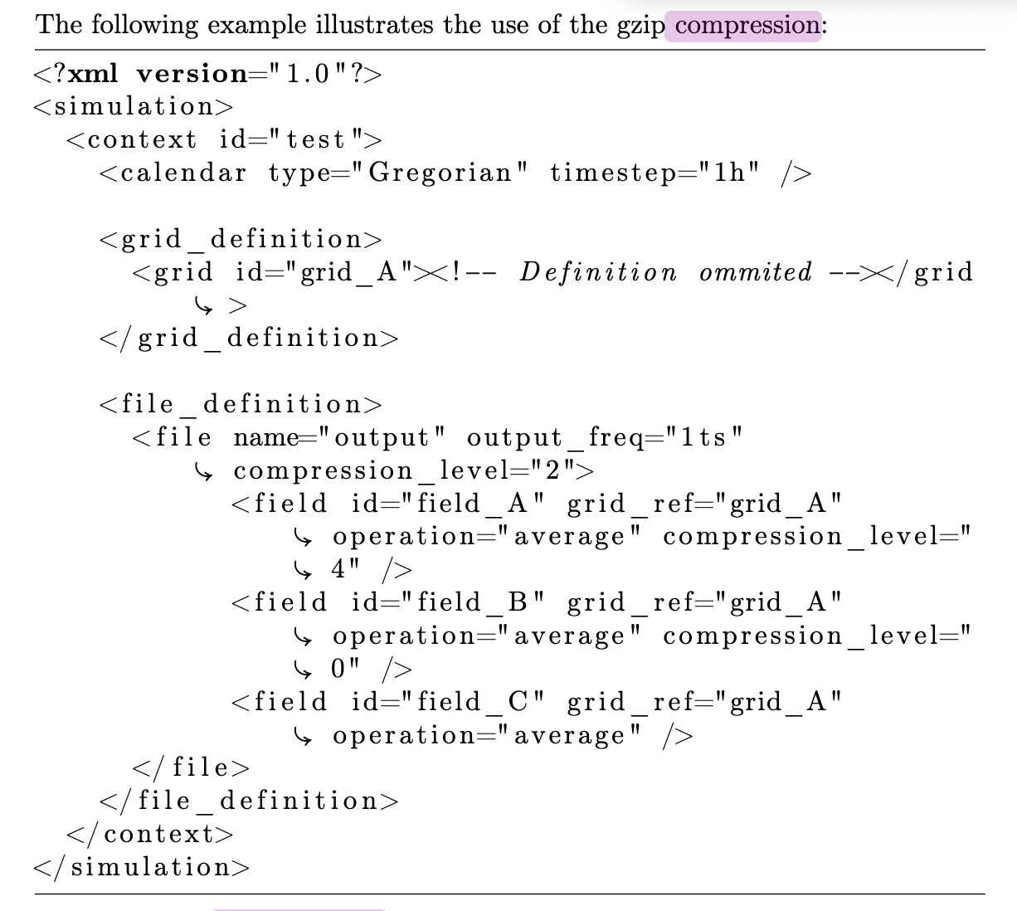
Study customize XIOS
The iodef.xml
Each field to be compressed requires the HDF5-filter definition in iodef.xml

Slide 16
Conclusion
Generate trace files from ns-sd-ran pod has been conducted
The IEIE paper has been submitted
The iodef.xml used to enable/disable the field of NetCDF compression in XIOS

Slide 17
Your opinion/thought
Configuring the iodef.xml to enable/disable compression is the primary step before moving into code modification.
Testing the H5Z-SZ filter needs to be performed before moving into implementing SZ in XIOS.

Slide 18
Action items
Convert yaml topology from RAN simulator into compatible ns-3 topology
Adjust the iodef.xml to enable XIOS default compression then evaluate the output model. Ensure the compression configuration is working.
Adjust the iodef.xml using the H5Z-SZ filter. Environment flags or source code modification may be required so the H5Z-SZ can be detected by XIOS.

